Slide 1

Hardware Acceleration Using FPGA
TU Chemnitz
Faculty of Electrical Engineering and Information Technology
Implementing a Digital Stopwatch for a FPGA Platform
Name : Shanmugapriyan Manoharan
Date : 13 Feb 2019

Slide 2
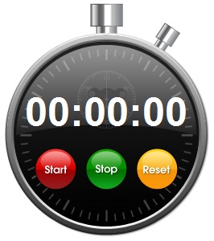
Outline
TU Chemnitz
Faculty of Electrical Engineering and Information Technology
Aim
Implementation
Top Structure
Stopwatch FSM & Design
Pushbutton debounce
Seven Segment Selector
Simulation Output
Result
Device Utilisation
Timing Report
Maximum Frequency
Conclusion
Reference

Slide 3
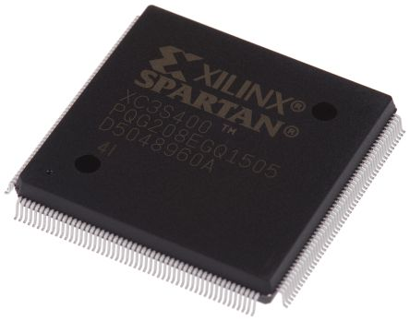
Aim
TU Chemnitz
Faculty of Electrical Engineering and Information Technology
To Design and Implement the Stopwatch on Spartan 3 FPGA

Slide 4
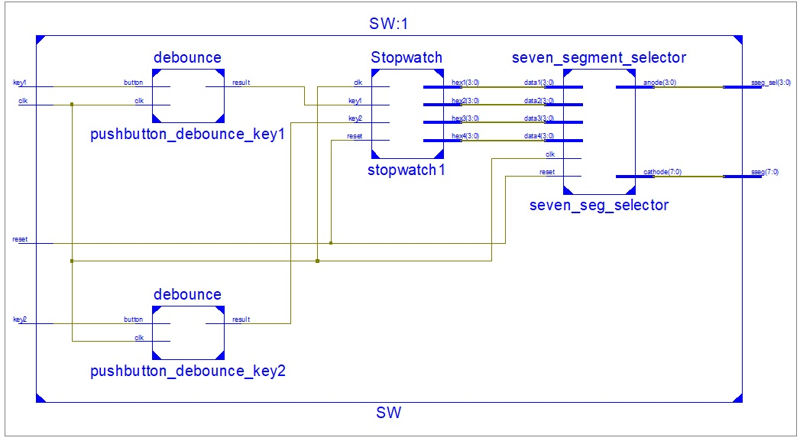
TU Chemnitz
Faculty of Electrical Engineering and Information Technology
TOP Structure

Slide 5
TU Chemnitz
Faculty of Electrical Engineering and Information Technology
Stopwatch FSM
Goes to 00:00
& Continue counting
Key2 = ‘1’
Run
reset = ‘0’
Key1 = ‘1’
Init
Key1 = ‘1’
Key1 = ‘1’
Key2 = ‘1’
Halt

Slide 6
TU Chemnitz
Faculty of Electrical Engineering and Information Technology
Stopwatch
Clk
IZero
hex0(s0)
State
IZero
IZero
Clk_1sec
Stopwatch_
Counter
hex1(s1)
Clock_Div_1sec
Output
hex2(m0)
Clk
SCount
SCount
hex3(m1)
Reset
Key2
Key1_
Pressed
State_
Register
State
Transition
nextState
Key1_
Counter
Clk
Key1

Slide 7

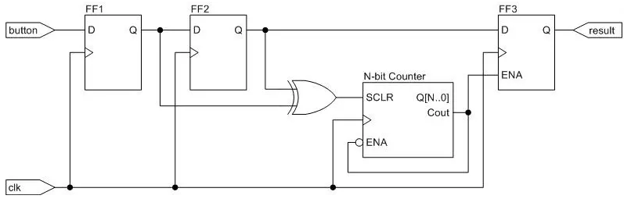
TU Chemnitz
Faculty of Electrical Engineering and Information Technology
Push Button Debounce
Expected
State
Actual
State

Slide 8
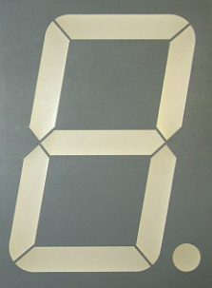
TU Chemnitz
Faculty of Electrical Engineering and Information Technology
Seven Segment Selector
data1[3:0]
Cathode
Conversion
Seven Segment
Cathode
Seven Segment
Decoded
Data[7:0]
data2[3:0]
Seven Segment
Decoder
Clk
data3[3:0]
Refreshing
Counter
data4[3:0]
Reset
Activating Signal
“1110”
“1101”
Seven Segment
Anode
Seven Segment Selector[3:0]
m1
m0
S1
S0
“1011”
“0111”

Slide 9
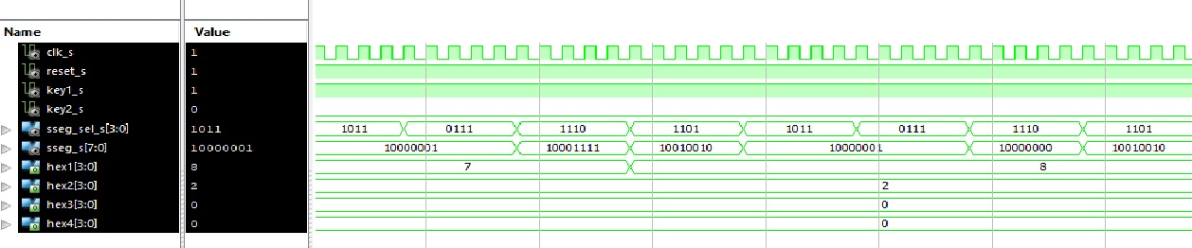
TU Chemnitz
Faculty of Electrical Engineering and Information Technology
Simulation Output

Slide 10
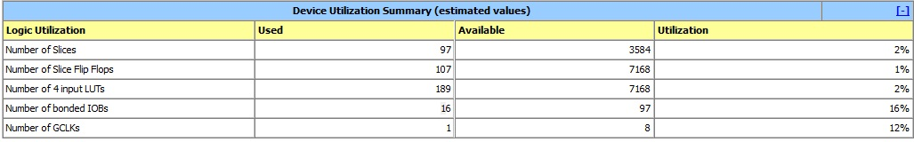
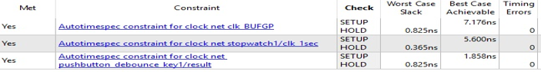
TU Chemnitz
Faculty of Electrical Engineering and Information Technology
Device Utilisation
Timing Report
Maximum Frequency: 132.468 MHZ

Slide 11
Conclusion
TU Chemnitz
Faculty of Electrical Engineering and Information Technology
The Digital Stopwatch is successfully designed, synthesised and implemented.
The implemented design is programmed into Spartan 3 FPGA and output is monitored.
11

Slide 12
References
TU Chemnitz
Faculty of Electrical Engineering and Information Technology
[1] https://www.digikey.com/eewiki/pages/viewpage.action?pageId=4980758 [Accessed on 11/02/2019]
[2] https://www.fpga4student.com/2017/09/vhdl-code-for-seven-segment-display.html
[Accessed on 25/01/2019]
12

Slide 13

TU Chemnitz
Faculty of Electrical Engineering and Information Technology
13

